Slide 1
Face Recognition
Group-1 Assignment-1
Daivat Bhatt (201501023)
Neel Shukla (201501063)
Rahulkumar Savariya (201501091)
Mohit Solanki (201501103)
Jeet Trivedi (201501111)

Slide 2
Problem Statement
Given set of face image dataset extract the SIFT features and HoG features and use them for matching the test image to the dataset by using three different approaches
Euclidean Distance
Shallow Neural Network
CNN

Slide 3
Approaches for Face Recognition
We used HoG feature extraction method to extract features from the set of face images and then applied three different methods which is listed below for feature matching to the test images of face
Euclidean Distance
Classification using multiclass SVM classifier
CNN
Second approach was SIFT feature extraction and feature matching with the given test image.

Slide 4

Euclidean Distance with HoG feature extraction
Dataset
(Face Images)
Preprocessing
(Image resize,
Color conversion)
HoG Feature Extraction
Euclidean Distance
Result
(Face matching)

Slide 5
Classification using multiclass SVM classifier with HoG feature extraction
Dataset
(Face Images)
Preprocessing
(Image resize,
Color conversion)
Splitting Dataset into Training and Validation
HoG Feature Extraction
(Image,Cell Size)
Modeling using
Multiclass Classifier SVM
Predict Test Image
Result
Notes:
Steps:
Resizing into 800 x 600 dimension
Creating image sets
Importing sets
Creating training and validation sets where 70% for training and 30% for validation.
Extracting HoG features from training set and assigning labels
Modeling classifier using training features and training labels
Extracting HoG features from validation set and assigning labels
Using model on validation set and predicting labels
Creating confusion matrix using test labels and predicted labels
Calculating precision and recall

Slide 6
Convolutional Neural Network
Preprocessing (Extracting Names, Image resizing and Roll No to image mapping)
Dataset
(Face Images)
Splitting Dataset into Training and Validation
Applying 2-Layered CNN Model
Predict Test Image
Result
Notes:
Steps:
Resizing into 800 x 600 dimension
Creating image sets
Importing sets
Creating training and validation sets where 70% for training and 30% for validation.
Extracting HoG features from training set and assigning labels
Modeling classifier using training features and training labels
Extracting HoG features from validation set and assigning labels
Using model on validation set and predicting labels
Creating confusion matrix using test labels and predicted labels
Calculating precision and recall

Slide 7
Input Image (300x300)
Convolutional Layer (32 filters of 3x3 kernel size)
Max Pooling (2x2 kernel size)
Convolutional Layer (64 filters of 3x3 kernel size)
Output
(42)
Fully Connected Layer
Fully Connected Layer
Max Pooling (2x2 kernel size)
Precision : 75.6%
Recall : 74%
F1 - Score : 74.79%

Slide 8
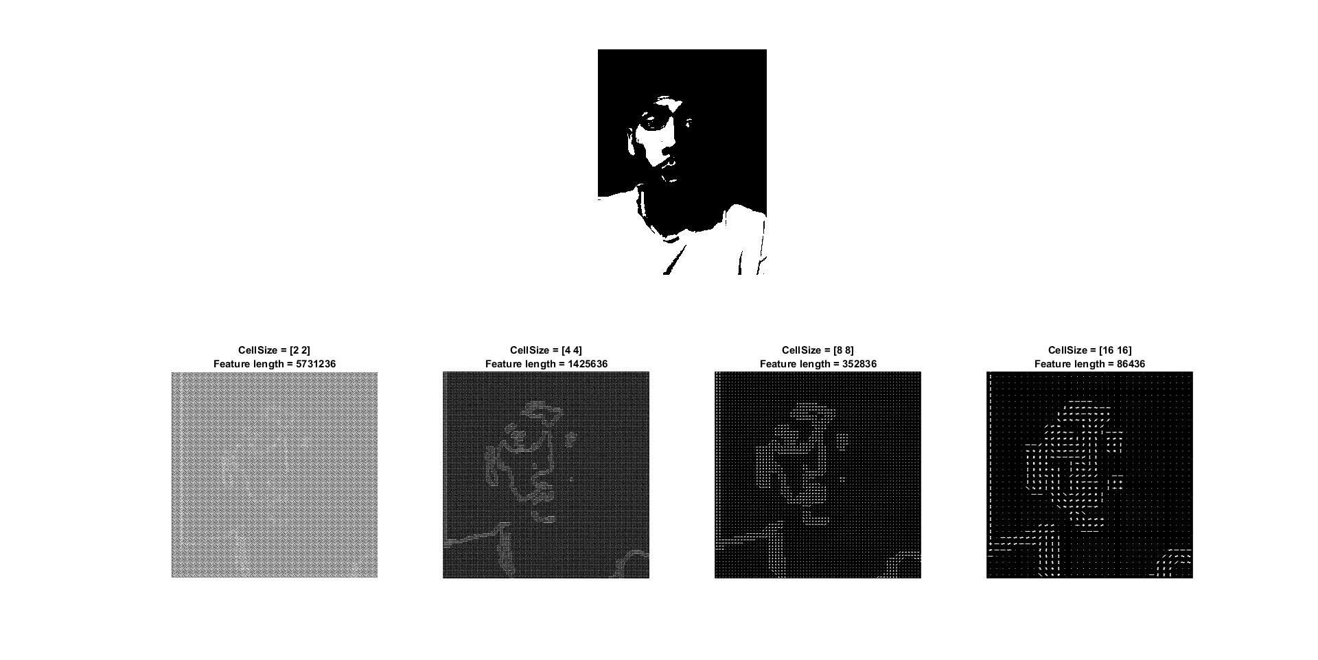
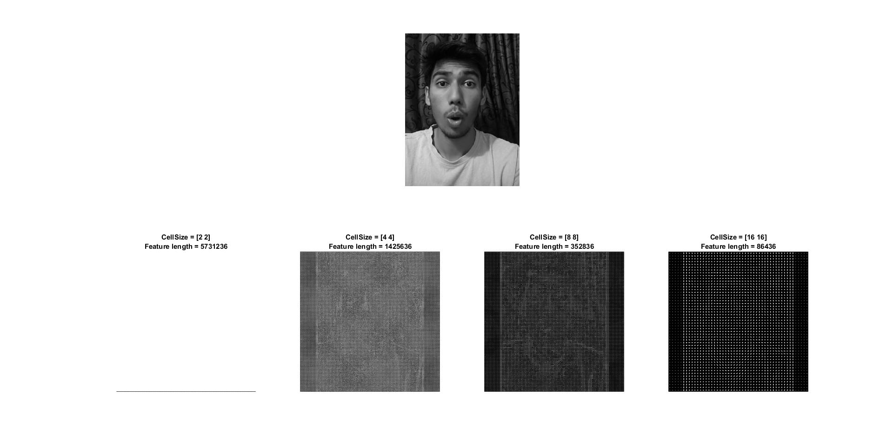
HoG Feature Extraction

Slide 9


Matching Result Obtained for Euclidean Distance
Original Image
Test Image
This result is obtained based on minimum value of euclidean distance

Slide 10
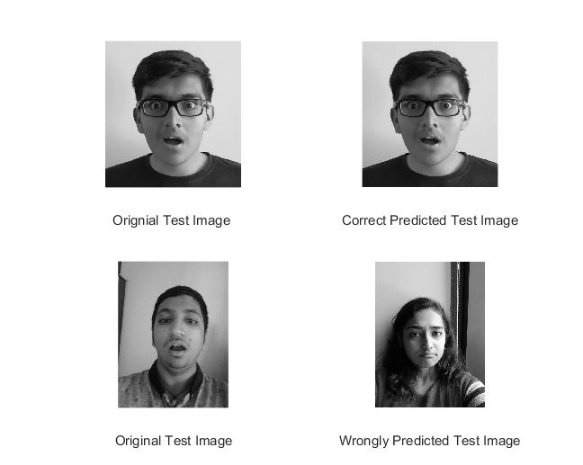
Matching Result Obtained for SVM
Test Set Accuracy: 85.29%

Slide 11


Result of CNN (Misclassification)
Predicted as 201501112 which is actually the image to the right

Slide 12
Training and testing images
Method (HoG Feature Extraction) | Dataset | No. of training images | No of testing images | Accuracy (percentage)
Euclidean Distance | 102 | 85 | 17 | 82.3
SVM | 204 | 170 | 34 | 85.29
CNN | 525 | 472 | 53 | 75.47

Slide 13
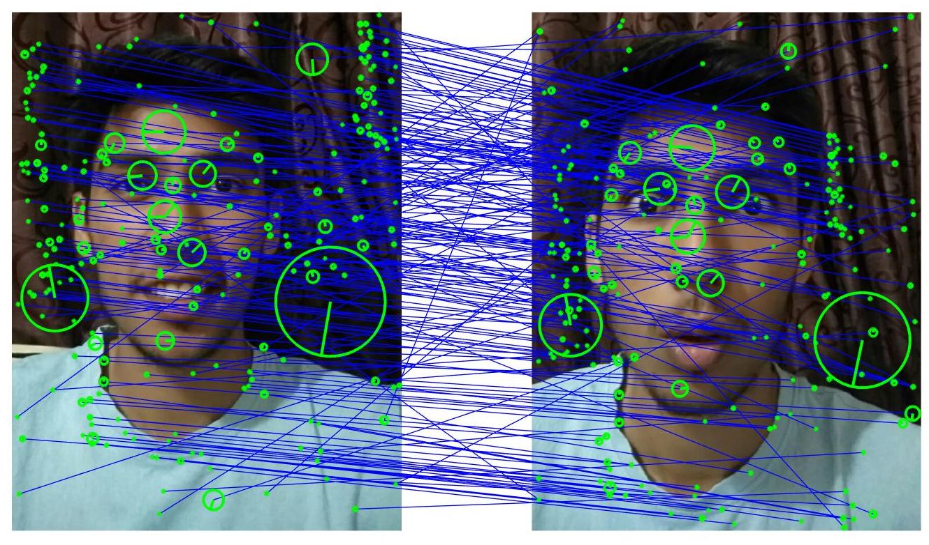
Implementation of SIFT
Original Image
Test Image

Slide 14
Conclusions
We perform HoG feature extraction for face recognition where we came to the conclusion that face recognition performance was better in case of SVM classification than Euclidean distance.
SVM performed better even with small dataset.
SIFT feature extraction implementation on few image and performed matching with one image for face recognition.
CNN gave less accuracy compared to SVM and Euclidean.
Notes:
The reason why we haven't used the SIFT features is because it gave a different amount of feature descriptors for each image. Even after removal of outliers, the quantity remained different implying that it needed manual removal — a process that would actually render everything pointless.

Slide 15
References
[1] H. Gao, L. Dou, W. Chen and J. Sun, ”Image classification with Bag-of-Words model based on improved SIFT algorithm,” 2013 9th Asian Control Conference (ASCC), Istanbul, 2013, pp. 1-6.
[2] Hongyan Zhang, Jiazhen Luo, Zihao Wang, Long Ma and Yifan Niu,”An accelerated matching algorithm for SIFT-like features,” 2017 2nd
International Conference on Image, Vision and Computing (ICIVC), Chengdu, 2017, pp. 103-107.
[3] K. T. Islam, R. G. Raj and A. Al-Murad, ”Performance of SVM, CNN, and ANN with BoW, HOG, and Image Pixels in Face Recognition,” 2017
2nd International Conference on Electrical & Electronic Engineering (ICEEE), Rajshahi, 2017, pp. 1-4.
[4] S. G. Bhele and V. H. Mankar, ”Recognition of Faces Using Discriminative Features of LBP and HOG Descriptor in Varying Environment,”2015 International Conference on Computational Intelligence and Communication Networks (CICN), Jabalpur, 2015, pp. 426-432.
[5] J. Yu and C. Li, ”Face Recognition Based on Euclidean Distance and Texture Features,” 2013 International Conference on Computational and
Information Sciences, Shiyang, 2013, pp. 211-213.

